Slide 1


Trauma and Resilience
from the Israeli Experience:
From survival mode to prevention
Ruth Pat-Horenczyk, Ph.D.
The Hebrew University of Jerusalem
Online Conference
April 27, 2023

Slide 2
Structure of the Presentation
Trauma of war and terrorism
School-Based Screening and Interventions
Early Childhood Projects
Continuity of Services: Trauma- Informed Interventions

Slide 3
Trauma is an emotional response to a terrible event like an accident, rape, or natural disaster. Immediately after the event, shock and denial are typical. Longer term reactions include unpredictable emotions, flashbacks, strained relationships, and even physical symptoms like headaches or nausea.
https://www.apa.org/topics/trauma

Slide 4
Psychological Trauma
Short term results
Traumatic event
Coping
Meaning
Long term results
Notes:
We tend to use the word “trauma” to describe different phenomena, sometimes we are referring to the traumatic events, or to the coping mechanism, or to the meaning of the event. We also may use the word trauma to describe the short term or long term results of the traumatic experience.

Slide 5
Trauma
Traumatic events overwhelm the usual methods of coping that give people a sense of control, connection and meaning.
Herman, JL Trauma and recovery (1992)

Slide 6
Related theoretical constructs
Normal reactions to trauma
Resilience
  More common than uncommon
  Ordinary Magic (Masten, 2001)
Survival mode
Cumulative trauma or Continuous Traumatic Stress (CTS)
  Allostatic load vs. Habituation
Long term consequences of exposure to trauma on the broad clinical picture
  (e.g., sensory and emotion regulation, attitudes, violent behavior)
Post Traumatic Growth

Slide 7
Hyper arousal and Hypo-arousal:
The bi-phasic response
Hyper-arousal
Window of tolerance:
The optimal level of arousal
Hypo-arousal
Ogden and Minton (2000)

Slide 8

The Posttraumatic Clusters (DSMV)
1. Re-experiencing of the event
2. Avoiding the stimuli connected to the traumatic event
3. Symptoms of hyper-arousal or hypo-arousal
4. Change in cognitions and emotions
5. Functional impairment
Memories, pictures and thoughts appearing during sleep and wake
Numbness, cutback of interest in the exterior world
Alertness and constant sense of emergency, numbness
Exaggerated blame of self or others, Negative affect, Inability to recall key features of the trauma
Impairment in learning, social or family functioning
Notes:
Negative thoughts or feelings that began or worsened after the trauma, in the following way(s):
Inability to recall key features of the trauma
Overly negative thoughts and assumptions about oneself or the world

Slide 9
Predictors of Posttraumatic Stress Disorder and Symptoms in Adults: A Meta-Analysis
Emily J. Ozer, Suzanne R. Best, Tami L. Lipsey, Daniel S. Weiss
Psychological Bulletin, 2003, Vol. 129, No. 1, 52–73
A review of 2,647 studies
476 potential candidates for a meta-analysis
68 studies met criteria for inclusion in a meta-analysis of 7 predictors
prior trauma,
prior psychological adjustment,
family history of psychopathology,
perceived life threat during the trauma,
posttrauma social support,
peritraumatic emotional responses
peritraumatic dissociation.
Missing from this analysis: Peritraumatic physiology

Slide 11
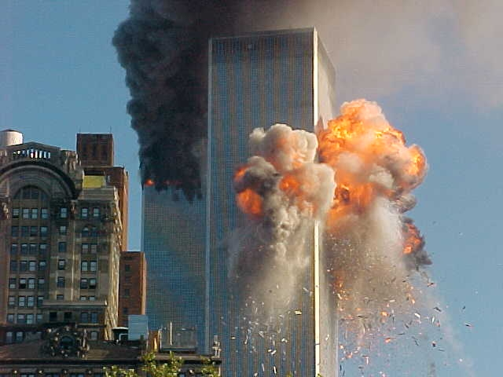
Terror in New-York

Slide 12
Findings from United States: report of the Ministry of Education,
(New York City, 6.5.02)
Survey of needs following 9/11
A sample of 8,266 school children in New York
Students from the 4th to 12th grade, some were near the twine tower, some were in more distant places
Was completed six months after 9/11
Done by Christina Hoven from Columbia University
Notes:
The NY board of education conducted a survey 6 months after 9/11 screening a sample of over 8,000 school children from 4th to 12th grade.

Slide 13
Ministry of Education, New-York City:
Referral for treatment
Most of the students (66%) with posttraumatic symptoms did not turn or were referred to treatment either within the school or in by mental health professionals in the community
Notes:
An important finding that should be highlighted is the fact that 2/3 of the students suffering from post-traumatic symptoms did not turn, and were not referred, for treatment. Neither teachers nor parents, though perhaps quite dedicated, know how to identify post-traumatic distress in children and adolescents. Therefore it is imperative to actively reach out to screen youth. The most effective method of discovering these symptoms is to ask children and youth directly.

Slide 14
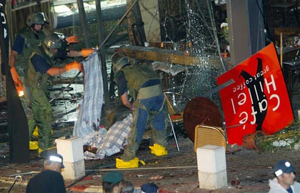
Terror in Israel (Second intifada, 2000-2008 ) Café Hillel – September 9, 2003
Notes:
Israel has, unfortunately, been subject to a constant stream of traumatic events in recent years. In addition to occurrences like everywhere else in the world: car accidents, rape, abuse – Israel has experienced a steady stream of terrorist attacks and suicide bombings. Here are the pictures of the bombing of Café Hillel, a popular café on a very busy street in Jerusalem

Slide 15
Why School Based Screening?
What do we screen for?
Chemtob et al. (2001, 2002) - Hurricane Andrew
    School based screening and treatment
Layne, Saltzman, Pynoos (2001) - Bosnia
  School based screening and interventions (also grief)
Hoven (2003) - 6 months after 9/11
    2/3 of the affected students were not identified by teachers
Pfefferbaum (1999,2003)- Oklahoma; Kenya and Tanzania
    Long term consequences
    Functional impairment
Wong (2003); Stein (2003) - Inner violence in LA
    Screening and treatment
In Israel: Solomon, Lavi, Laufer, Laor, Wolmer
  Political violence, Israelis & Palestinians, War
  Risk and protective factors, political attitudes, PTG
15
Notes:
15

Slide 16
Why School Based Screening?
Reaching out to children in their natural environment
No Stigma
Cost effective
Identifying children who “suffer in silence”
Part of a comprehensive “system of care” within the school system and community
16

Slide 17
Focus on Children and Schools
Effects of Trauma on the Ability to Learn
A traumatic event can seriously interrupt the school routine and the processes of teaching and learning
Students traumatized by exposure to violence have been shown to have lower grade point averages, more negative remarks in their cumulative records, and more reported absences from school than other students.
They may have increased difficulties concentrating and learning at school and may engage in unusually reckless or aggressive behavior.

Slide 18
What did we screen for?
Screening Instruments
Israeli Trauma Exposure (Pat-Horenczyk et al. 2002)
UCLA PTSD Reaction Index-Adolescent Version (Rodriguez, Steinberg & Pynoos, 1999)
or Posttraumatic Diagnostic Scale (PDS) Foa, Cashman, Jaycox, & Perry, 1997
Functional Impairment Taken from the Diagnostic Predictive Scales (DPS), based on the Child Diagnostic Interview Schedule (Lucas et al.,2001)
Brief Beck Depression Inventory (Beck & Beck, 1972)
Somatization Scale Taken from the Diagnostic Predictive Scales (DPS), based on the Child Diagnostic Interview Schedule (Lucas et al.,2001)
Protective factors: social support, self efficacy, ego resilience, flexibility, optimism, etc
Pat-Horenczyk, R. (2004). Post-traumatic distress in Israeli adolescents exposed to ongoing terror: Findings from a school-based screening project in the Jerusalem Area. Journal of Aggression, Maltreatment and Trauma, 9, (No. 3/4), 335-247.
Notes:
Let me briefly present to you the screening instruments.

Slide 19
Screening for posttraumatic symptoms
Part of a Comprehensive Model for School Based Interventions
Ecological model
Teachers’ training
Parents meetings
Screening students (and teachers)
building resilience workshops (for all students)
School based group treatment (for identified students)
  6-sessions protocol for student with anxiety symptoms
  12-sessions protocol for student with PTS
  Berger, R. Pat-Horenczyk, R. & Gelkopf, M. A (2007) School-based intervention for the prevention and treatment of elementary students' terror-related distress in Israel: A randomized control trial. Journal of Traumatic Stress, 20 (4), 541-551.
Baum, N.L, Lopes Cardozo, B., Pat-Horenzcyk, R., Ziv, Y., Blanton, C., Reza, A., Weltman, A. Brom D.. (2013). Training teachers to build resilience in children in the aftermath of war: A cluster randomized trial. Child and Youth Care Forum, 42, 339-350. (DOI: 10.1007/s10566-013-9202-5).
Notes:
Baum, N.L, Lopes Cardozo, B., Pat-Horenzcyk, R., Ziv, Y., Blanton, C., Reza, A., Weltman, A. Brom, D. (2013). Training teachers to build resilience in children in the aftermath of war: A cluster randomized trial. Child and Youth Care Forum, 42, 339-350. (DOI: 10.1007/s10566-013-9202-5).
Kletter, H., Rialon, R. A., Laor, N., Brom, D., Pat-Horenczyk, R., Shaheen, M., Hamiel., D., Chemtob, C.,Weems, C. F., Feinstein, C., Lieberman, A., Reicherter, D., Song, S., & Carrion, V.G. (2013). Helping children exposed to war and violence: Perspectives from an international work group on interventions for youth and families. Child & Youth Care Forum, 42, 371-388. (DOI: 10.1007/s10566-013-9203-4).

Slide 20
Why Screen Traumatized Students?
(and Train Teachers)
One night several years ago, I saw men shooting at each other, people running to hide. I was scared and I thought I was going to die. After this happened, I started to have nightmares. I felt scared all the time. I couldn’t concentrate in class like before. I had thoughts that something bad could happen to me. I started to get in a lot of fights at school and with my brothers.
Martin, 6th grader
Taken from Marleen Wong
20

Slide 21
Findings from the Screening Project in Israel
Israeli Adolescents Facing Ongoing Violent Conditions: Exposure Data (N=5610)
Direct Exposure
Presence at a violent attack or
knowing someone who was hurt or
killed in a terrorist attack
Indirect Exposure
Being near a violent attack, before/after, or planned to be
at the site of an attack
No Exposure
No reported exposure to violent attacks
except of media coverage
Notes:
The exposure measure was divided to 3 categories: of direct exposure, Indirect exposure and No exposure.
Direct or personal exposure refers to the actual presence in a terrorist attack or knowing someone close to you who was killed or injured. It should be noted that this is not the traditional use of the term “direct exposure”, but with regard to children and adolescents, a family member who is killed or injured carries severe consequences which are no less than being directly exposed themselves.
Indirect exposure refers to what we call “near miss” experiences, that is, the feeling that one can vividly visualize how it almost could have happened. This also effects those who were present just before or after, or had planned to be on the site of the event.
No exposure refers to those exposed only by way of media coverage, without personal involvement.

Slide 22
A voice of a “non exposed” 14 year old
T., a 14-year-old boy, lives in a Jerusalem neighborhood. Asked about his personal experiences during the Al Aqsa Intifada, he replied that nothing has happened to him. Later, it emerged that his mother was driving her car when the bus next to her exploded; his father was on his way to lunch at a pizzeria that was bombed just a few minutes before he arrived; his cousin’s boyfriend was killed in a suicide bombing in the city center; and a rocket fell in the courtyard of his junior-high school. For months, T.’s neighborhood was repeatedly targeted by sharpshooters and rocket launchers. Living near a main road that leads to a major hospital, he constantly hears the sirens of the ambulances rushing past. T. “knows” that he is next.
Pat-Horenczyk, et al. (2007). Adolescent Exposure to Recurrent Terrorism in Israel: Posttraumatic Distress and Functional Impairment American Journal of Orthopsychiatry, 77 (1), 76-85.
Brom, D., Pat-Horenczyk, R. & Baum, N.L. (2011). The influence of war and terrorism on posttraumatic distress among Israeli children. International Psychiatry, 8 (4), 81-83.
Chemtob, C., Pat-Horenczyk, R., Madan, A., Pitman, S.R., Wang, Y., Doppelt, O., Dugan Burns, K., Abramovitz, R. & Brom, D. (2011).Israeli adolescents with ongoing exposure to terrorism: Suicidal ideation, posttraumatic stress disorder, and functional impairment Journal of Traumatic Stress, 24(6), 756–759.
Notes:
After trying to clarify the different exposure categories, let me give you an example of an individual case of a boy who regarded himself as non-exposed.

Slide 23
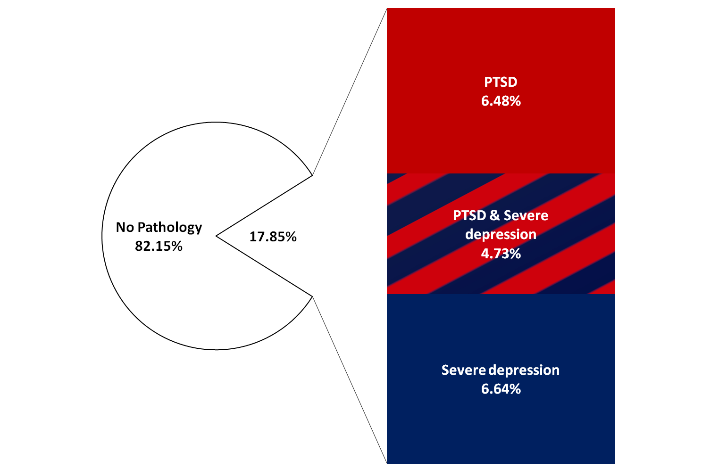
Resilience is Common
PTSD and Depression in Adolescents (N = 4274)
Notes:
23
23

Slide 24

Resilience
Resilience is Ordinary Magic
Ann Masten, 2001

Slide 25
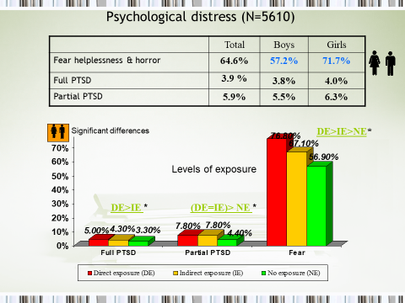

Slide 26
Gender differences : PTSD
school, terrorism
Posttraumatic Symptoms
Functional Impairment
★★★
★★
26
Notes:
26

Slide 27
Gender differences: Related Distress
school, terrorism
Depressive symptoms
Somatic complaints
★★★
★★
27
Notes:
27

Slide 28
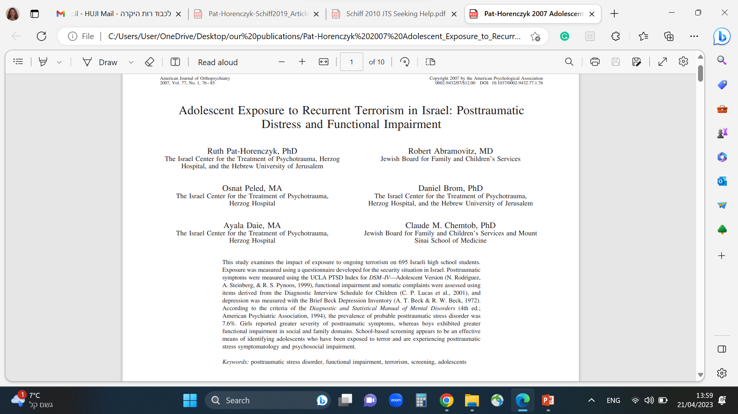
The toll of exposure to recurrent terrorism in Israel

Slide 29
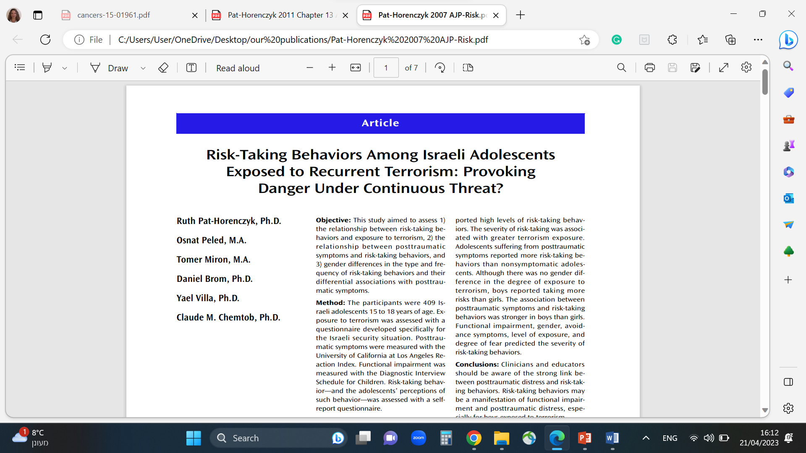
Trauma and Risk Taking Behavior
Does the exposure to ongoing terrorism influence risk-taking behaviors?
FACT: There has been evidence of an increase in substance abuse, violence, reckless driving, and other risk-taking behaviors among Israeli adolescents in the last few years
(Statistical Yearbook of the Council for the Welfare of the Child, 2003)

Slide 30
Exposure to trauma and risk taking behaviors in adolescents
Theoretical perspective:
Risk-taking behaviors satisfy the need to re-experience the trauma through “re-enactment”
Trauma influences perceptions of the world and future orientation
Trauma leads to hyper-arousal and thus may promote sensation seeking
Risk-taking behaviors can also be perceived as a way for adolescents to cry for help and express personal distress
Notes:
There are several theoretical explanations regarding the relationship between traumatic experiences and risk-taking behavior.

Slide 31
What Risk Taking Behaviors do Adolescents
with Full or Partial PTSD Present?
Total (n=42) | Girls (n=21) | Boys (n= 21)
34.2% | 16.6% | 54.2% | Fights
42.3% | 43.8% | 40.4% | Smoking cigarettes
12.5% | 9.2% | 16.1% | Using drugs
18.1% | 10.1% | 27.1% | Dangerous driving
15.6% | 9.7% | 22.4% | Unprotected sex
61.6% | 53.0% | 71.4% | Drinking alcohol
8.6% | 3.7% | 14.1% | Dangerous roulette games
68.5% | 60.8% | 77.1% | Disobey school
64.1% | 61.8% | 66.7% | Disobey parents
66.7%
23.8%
45.2%
61.9%
66.7%
64.3%
28.6%
14.3%
21.4%
28.6%
14.3%
21.4%
33.3%
19.0%
26.2%
81.0%
81.0%
81.0%
23.8%
9.5%
16.7%
76.2%
90.5%
83.3%
85.7%
66.7%
76.2%
Notes:
Here are the results of the reported risk-taking behavior by the students. At first, we did not anticipate the high level of straightforward reporting and disclosure from the students to the questionnaire. The first numbers represent the level of self-report of this risk taking behavior among the entire student population. The larger numbers correspond to the specific group of students who suffer from post-traumatic symptoms. So you can see that risk taking behaviors are twice as prevalent among this affected group of students. For example…
It should be noted, that its not the mere exposure to trauma, but those students who identify with post-traumatic stress symptoms also report much higher levels of risk-taking behavior.
The conclusion is, when you find PTSD, it is important to ask and look for risk-taking behavior, and when one encounters risk taking behavior, look for possible post-traumatic distress.

Slide 32
In their own words:
“Some things that seem “not dangerous” can be deadly, like taking a bus to school, and some things that are considered “dangerous” may be harmless…”
“If life is short, then we should make the most of it,” is understood as “let’s take chances”
“I prefer to decide what to do with my life and not let them decide for me…”
Notes:
Lets listen to the ways that these adolescents describe their experiences with regard to danger and risk.

Slide 33
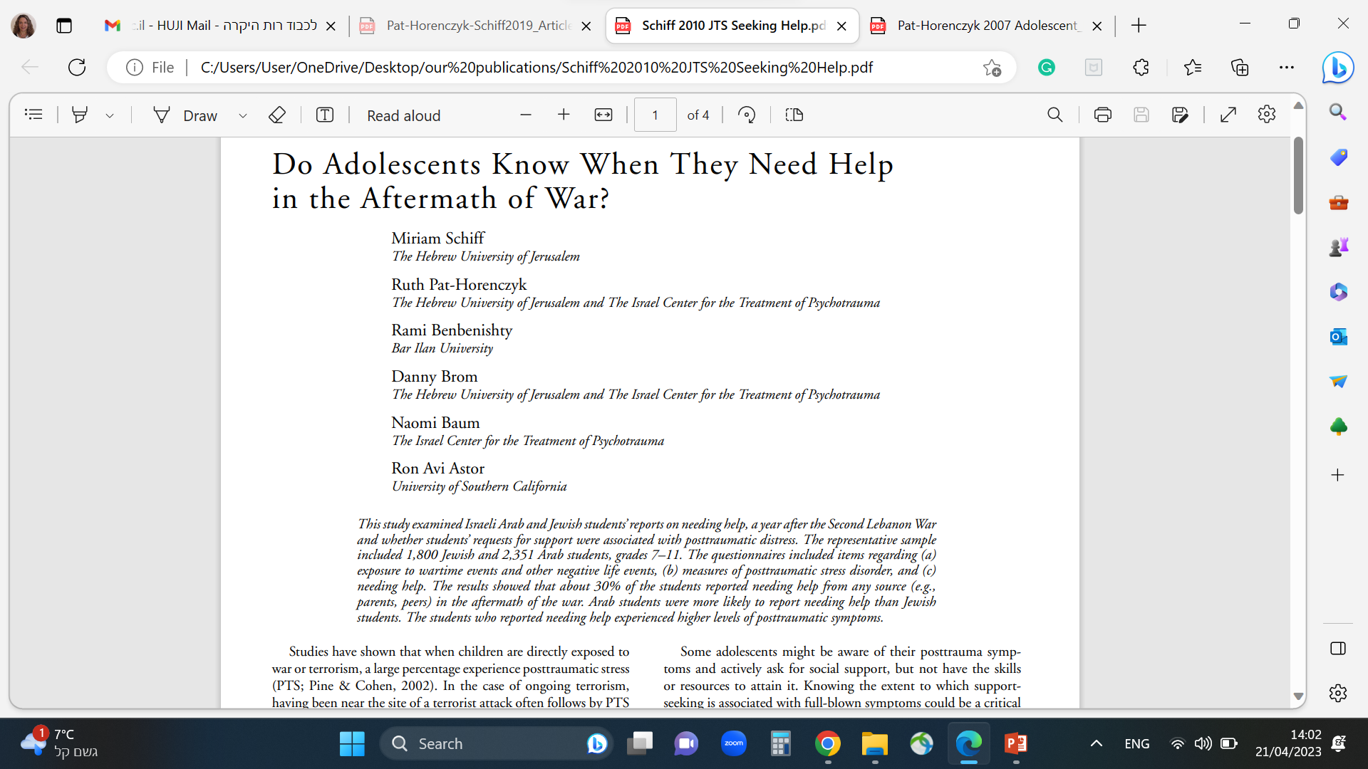
Do Children and adolescents know if they need help?
Ask them !
Notes:
Schiff, M., Pat-Horenczyk, R., Benbenishty, R., Brom, D., Baum, N., & Astor, R.A. (2010). Do adolescents know when they need help in the aftermath of war? Journal of Traumatic Stress, 23(5), 657-660.
Schiff, M., Pat-Horenczyk, R. & Peled, O. (2010). The Role of Social Support for Israeli Adolescents Continually Exposed to Terrorism: Protective or Compensatory Factors? Journal of Child & Adolescent Trauma, 3 (2), 95-108.

Slide 34
Needing Help
Do you need help? Yes/ Not sure/ No
34

Slide 35
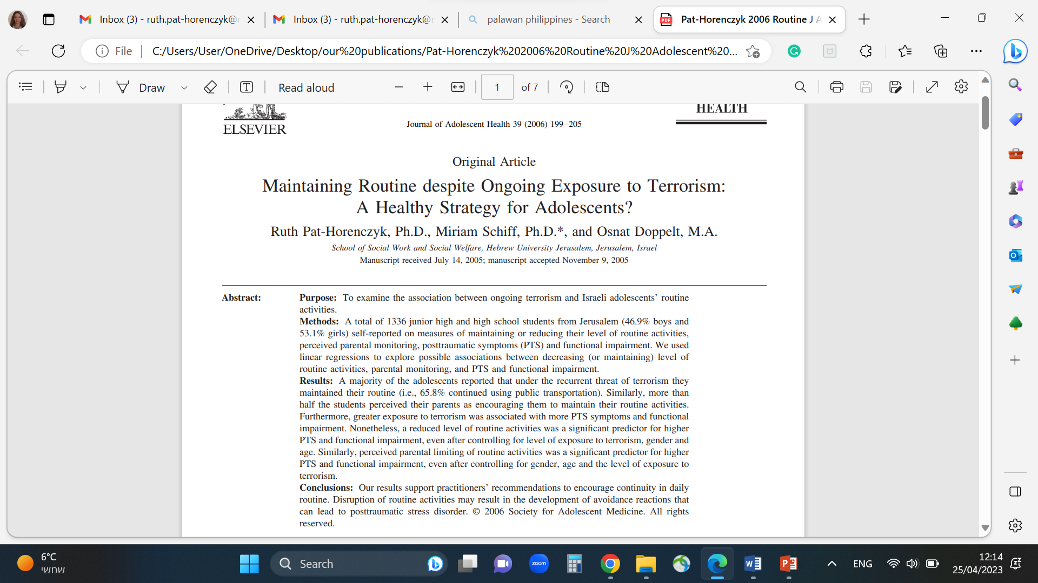
Maintaining the Routine?
Our results support practitioners’ recommendations to encourage continuity in daily routine. Disruption of routine activities may result in the development of avoidance reactions that can lead to posttraumatic stress disorder.
Pat-Horenczyk R .et al. (2006). Maintaining Routine despite Ongoing Exposure to Terrorism: A Healthy Strategy for Adolescents? Journal of Adolescent Health, 39 (2), 199-205.

Slide 36
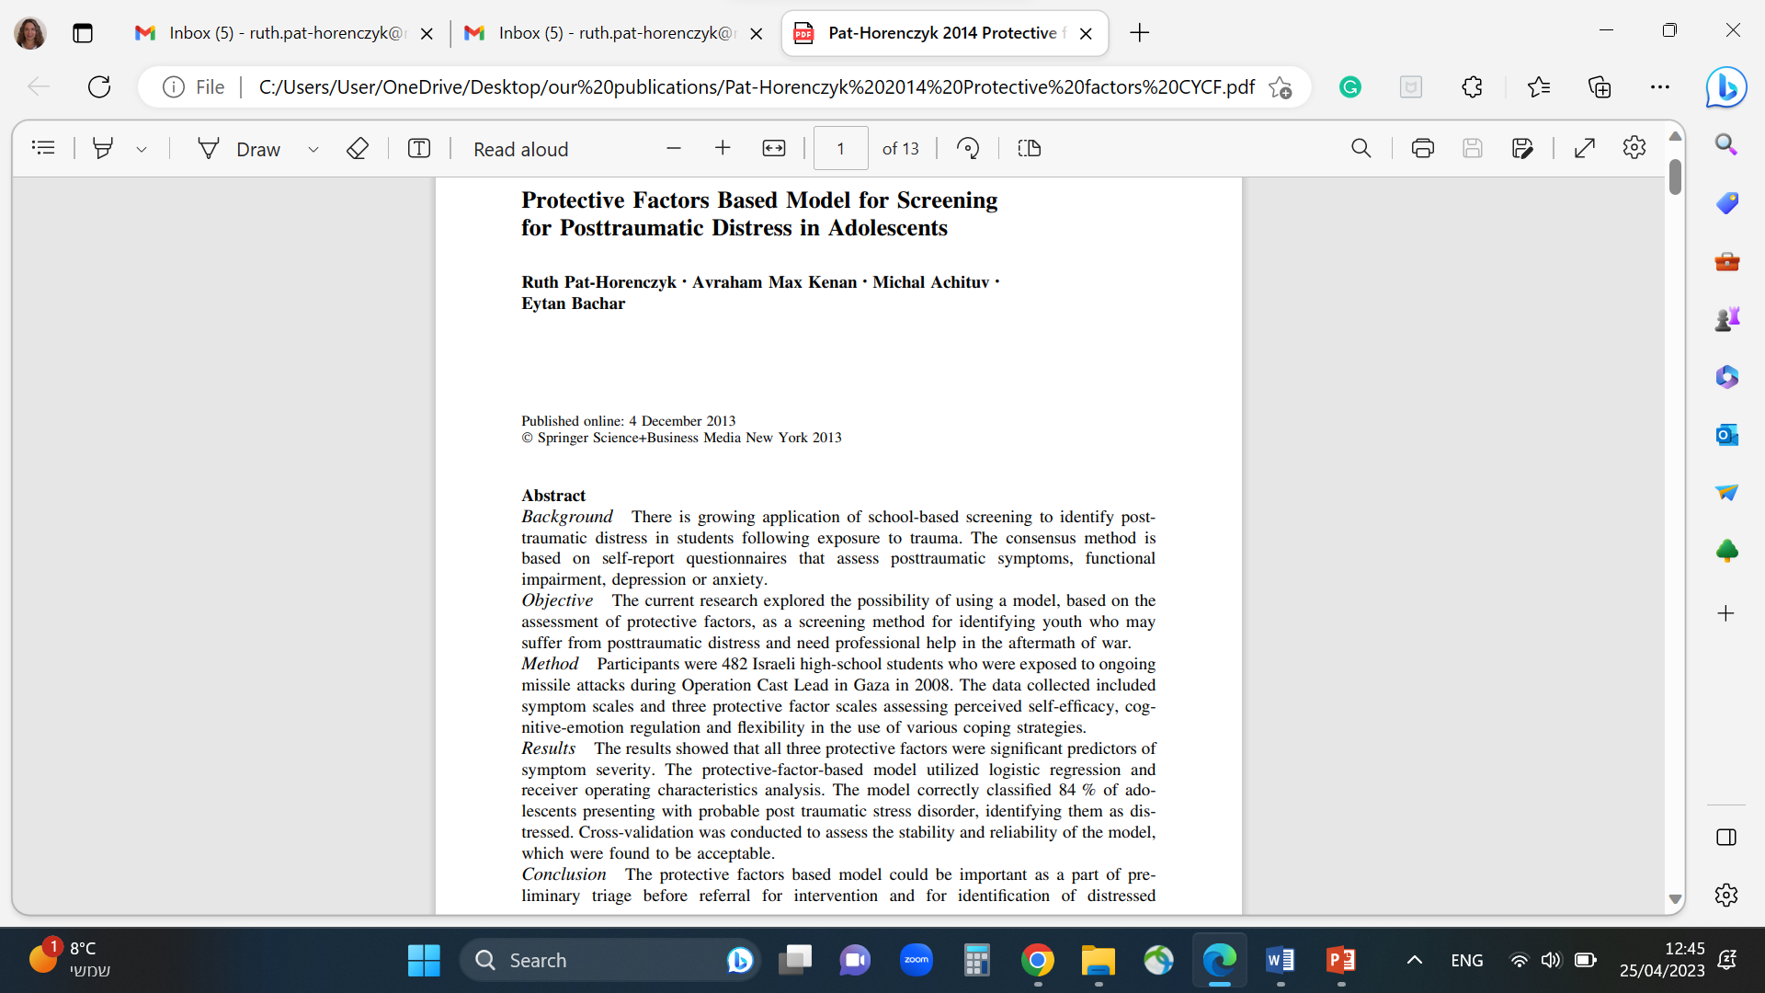
Protective Factors
We tested:
Self Efficacy
Coping(CERQ)
Flexibility
And showed that
Social Support
Seeking Help
Maintaining Routine
May protect and mitigate the distress
More protective factors
Altruism
Optimism

Slide 37
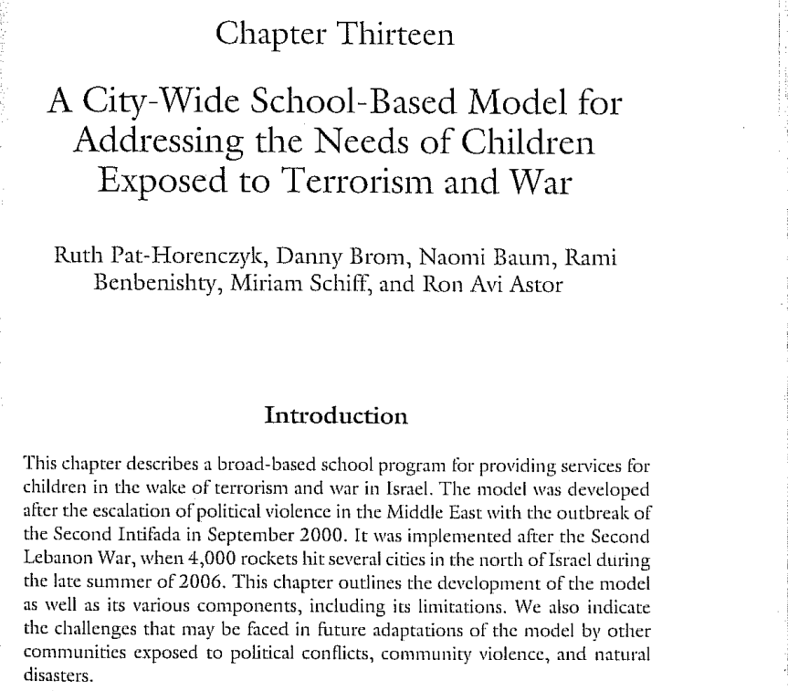
City wide Approach
Speaking the Language of Resilience

Slide 38
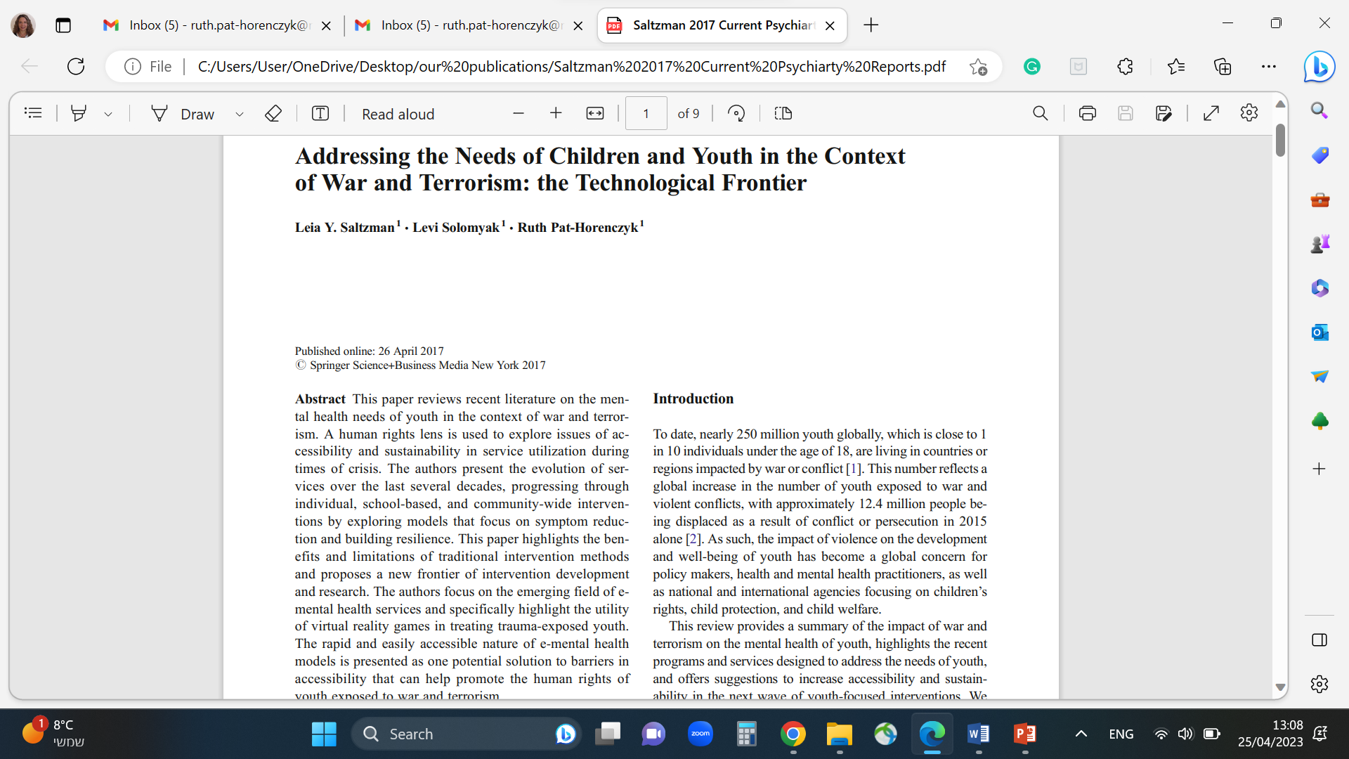

Addressing the Needs of Children and Youth in the Context of War and Terrorism:
The Technological Frontier
Notes:
Saltzman, L.Y., Solomyak, L., & Pat-Horenczyk, R. (2017). Addressing the Needs of Children and Youth in the Context of War and Terrorism: The Technological Frontier, Current Psychiatry Reports, 19(6), 30. DOI: 10.1007/s11920-017-0786-6.

Slide 39



A Window Into Parenthood under Stress:
Coping with ongoing threat of missiles
Notes:
39

Slide 40
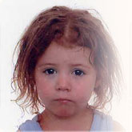
Is young age
a risk factor or a protective factor
for long term effects of trauma in children?

Slide 41
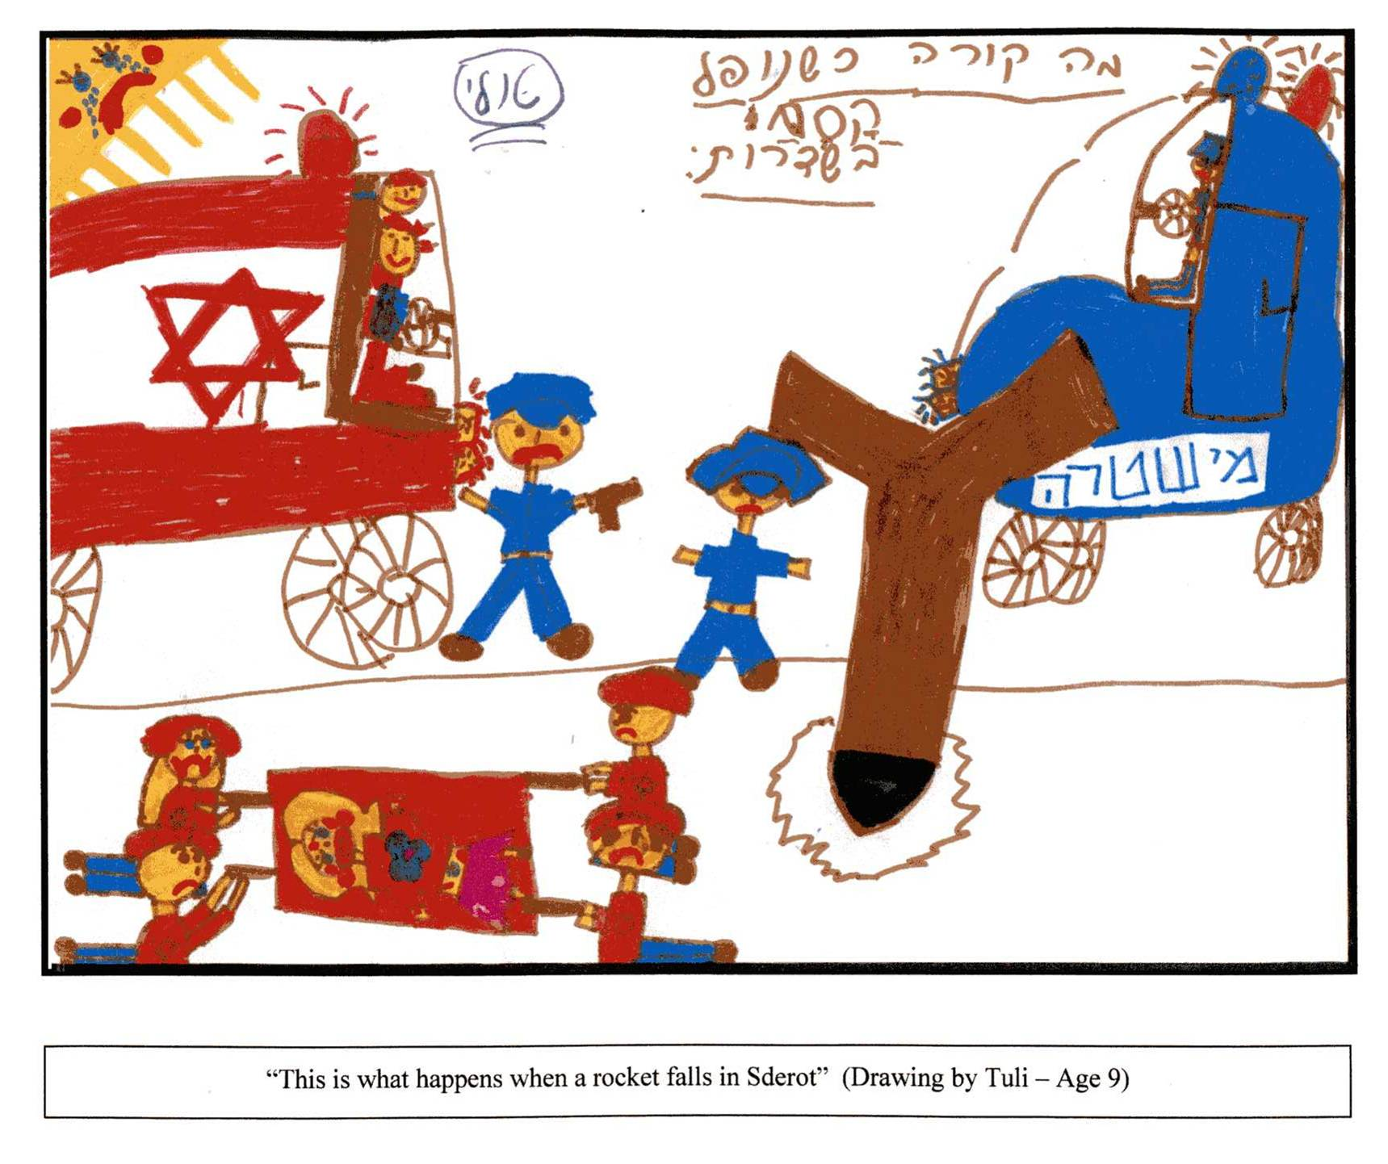
Red Color

Slide 42
Symptoms of Toddlers and Parents
Symptoms among Toddlers (n=225):
Symptoms among Parents
(n=239):
40% | Refusal to sleep alone
25% | Trouble falling asleep
24% | Intensive crying
18% | Restlessness when separated from parents
18% | Child is fearful and anxious
17% | Waking during the night
16% | Restlessness and inability to sit quietly
33% | Impairment in enjoyment and leisure activities
26% | Startled response to noise
24% | Functional impairment at work
22% | Irritability and restlessness
22% | Trying not to think about the events
21% | Trouble with concentration
18% | Sleep difficulties
12% | Functional impairment in household duties
Pat-Horenczyk, R., et al. (2012). Growing up under fire: Building resilience in young children and parents exposed to ongoing missile attacks. Journal of Child & Adolescent Trauma, 5(4), 303-314.

Slide 43
Developmental adjustment of the criteria for the diagnosis of PTSD among toddlers according to Scheeringa (2003)
Developmental adjustment
  Symptoms of re-experiencing are expressed during play and re-enactment
  Memories of the event - a direct expression of distress is not required
  Loss of interest in the day care activity
  Social withdrawal
  Restriction of play
  General fears
  Nightmares not specifically associated to a traumatic event
A change beyond normative developmental characteristics: more separation anxiety, more hyper arousal
Different number of symptoms required (one of each cluster)
Scheeringa, M. S., Zeanah, C. H., Myers, L., & Putnam, F. W. (2003). New findings on alternative criteria for PTSD in preschool children. Journal of the American Academy of Child and Adolescent Psychiatry, 42(5), 561–570. https://doi.org/10.1097/01.CHI.0000046822.95464.14

Slide 44
A Window Into Parenthood under Stress:
Coping with ongoing threat of missiles
Parental Voices
“Everything changes, when my child feels insecure he doesn’t play, or try new things.”
“When she hears ‘Red Color’ again everything freezes. She regressed back to behaving like a baby, bedwetting and asking for a bottle, or pacifier.”

Slide 45
Parenthood in crisis
“..this fear of abandonment …it’s been since the war….during the war I never left her for a moment.. except for one time when she said she wanted to go to the toilet… and I, instead of overcoming my fears and showing her whose the grownup…I told her, I don’t care, pee on yourself, I am not leaving here (the shelter). I did some damage, irreversible damage to my children during the war.. And I see the results, I see how he is afraid of every little noise… I myself am a coward what can I do, it is out of my hands.. There are situations when I can tell them don’t be afraid, but in other times I feel powerless, what can I do?”
“At that moment I felt as if I was a child -exactly like her, like what do I do? Where is our security, where? But wait, wait I am the mom- I should show here that… my head was confused I felt like her, I felt like she should be the mother now.”

Slide 46
Guilt
“I feel wrong as a parent, that I expose my children, living with them in a dangerous place….I feel pain and sadness that he is afraid, that he is going trough his childhood in fear, and not in pleasure like children in Tel-Aviv. It hurts that you can’t raise your children in a normal environment…it’s frustrating that economically I cant take the family, convince my wife to go to a safer place, where he can go out whenever he wants… I limit his childhood and its hard…”

Slide 47
Post traumatic growth
“She is much more empathetic to other people’s pain – for her young age. She might have lost some of her childhood however she also acquired something meaningful. I don’t think this would have happened had she not been through this experience.”

Slide 48
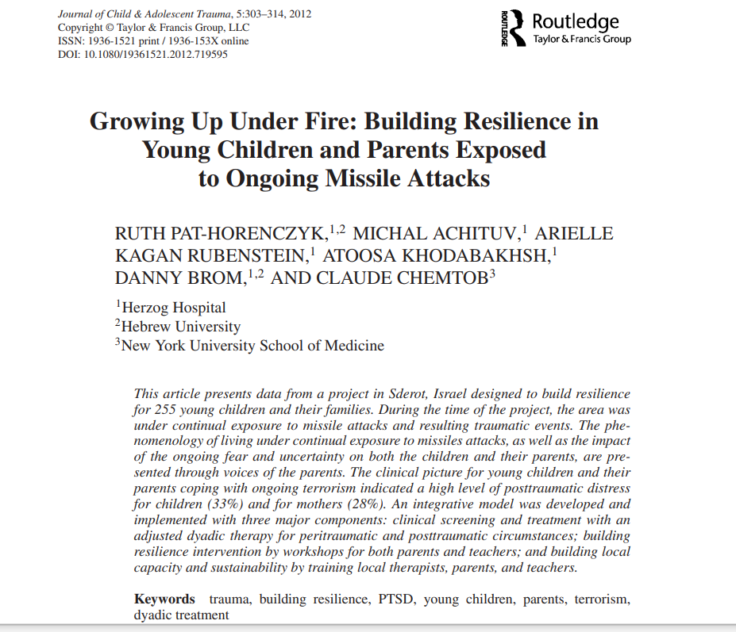
Growing up under fire

Slide 49

Relational PTSD in the face of ongoing terrorism

Slide 50
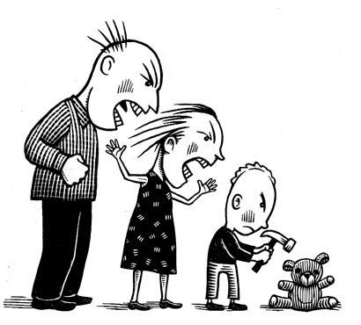
Relational PTSD
Scheeringa & Zeanah (2001) proposed the concept of RELATIONAL PTSD
“the co-occurrence of Posttraumatic stress simultaneously in parent and child“
When the symptomatology of one partner (usually the adult) exacerbates the symptomatology of the other (child)
although there is co-regulation and influences from both sides
Notes:
Given the crucial role of parents in early childhood, there is a need to study, in addition to the child’s experiences, the relationship between the parents’ experiences and behaviors and their effect on their young children.
Relational Posttraumatic Distress
The relationship between maternal and child psychopathology in the face of trauma
Especially strong for young children
The direction is most likely from parent to child (Scheeringa & Zeanah, 2001) although there is co-regulation and influences from both sides

Slide 51
The Search for Mediating and Moderating Factors in Relational PTSD
Attachment
Reflective
Functioning
Parent’s Posttraumatic
Symptoms
Child’s Posttraumatic
Symptoms
Parent’s Depressive
symptoms
Parental
Attunement
Parental
Competence
Parental Emotion Regulation

Slide 52
Why emotion regulation is relevant to trauma?
How can the construct of Emotion Regulation be helpful for understanding the phenomenon of relational PTSD?
How can the framework of emotion regulation contribute to the understanding of the intergenerational transmission of posttraumatic distress
Can it provide insights for clinical interventions?

Slide 53

Relational Emotion Regulation in the Face of Trauma
TRAUMA
Mother regulates herself
(internal process)
Mother regulates child
(external process)
Child regulates himself/herself
(internal process)
Sensitivity
Attunement
Reflective
functioning
Modeling, etc.
Post-traumatic symptoms
Child maladjustment, externalizing problems

Slide 54
How to measure parental emotion regulation?
The Difficulties in the Emotion Regulation Scale –DERS
(Gratz and Roemer, 2004)
Assess multiple aspects of maternal emotion regulation problems:
  Non acceptance of emotional responses
  (“When I’m upset, I feel guilty for feeling that way”)
  Difficulties engaging in goal directed behavior
  (“When I’m upset, I have difficulty concentrating”)
  Impulse control difficulties
  (“When I’m upset, I lose control over my behaviors”)
  Lack of emotional awareness
  (“I am attentive to my feelings”)
  Limited access to emotion regulation strategies
  (“When I’m upset, I believe that I’ll end up feeling very depressed”)
  Lack of emotional clarity
  (“I have difficulty making sense out of my feelings”)

Slide 55
Maternal Emotion Regulation Mediates the Impact of Maternal Posttraumatic on Child’s Symptoms
Mediation model (N=431)
Correlation between PTSD and ER of the mother is
0.436***
Maternal emotion regulation problems
R² =.176
a = .420
b = .225
Maternal posttraumatic symptoms
R² =.052
Child’s emotion regulation problems
R² =.125
c’ = .148
.229
-.087
-.163
Maternal exposure to traumatic events
Child’s gender (female)
Chi Square = 1.401 (df = 4), p = .844; NFI = .992; GFI = .999; SRMR =.012; RMSEA < .001
Pat-Horenczyk at al. (2015). Emotion regulation in mothers and young children faced with trauma. Infant Mental Health Journal, 36(2), 1-12.
Notes:
Maternal emotion regulation problems was found to mediate the association between maternal post traumatic symptoms and child’s regulation deficits - as measured by the CBCL DP

Slide 56
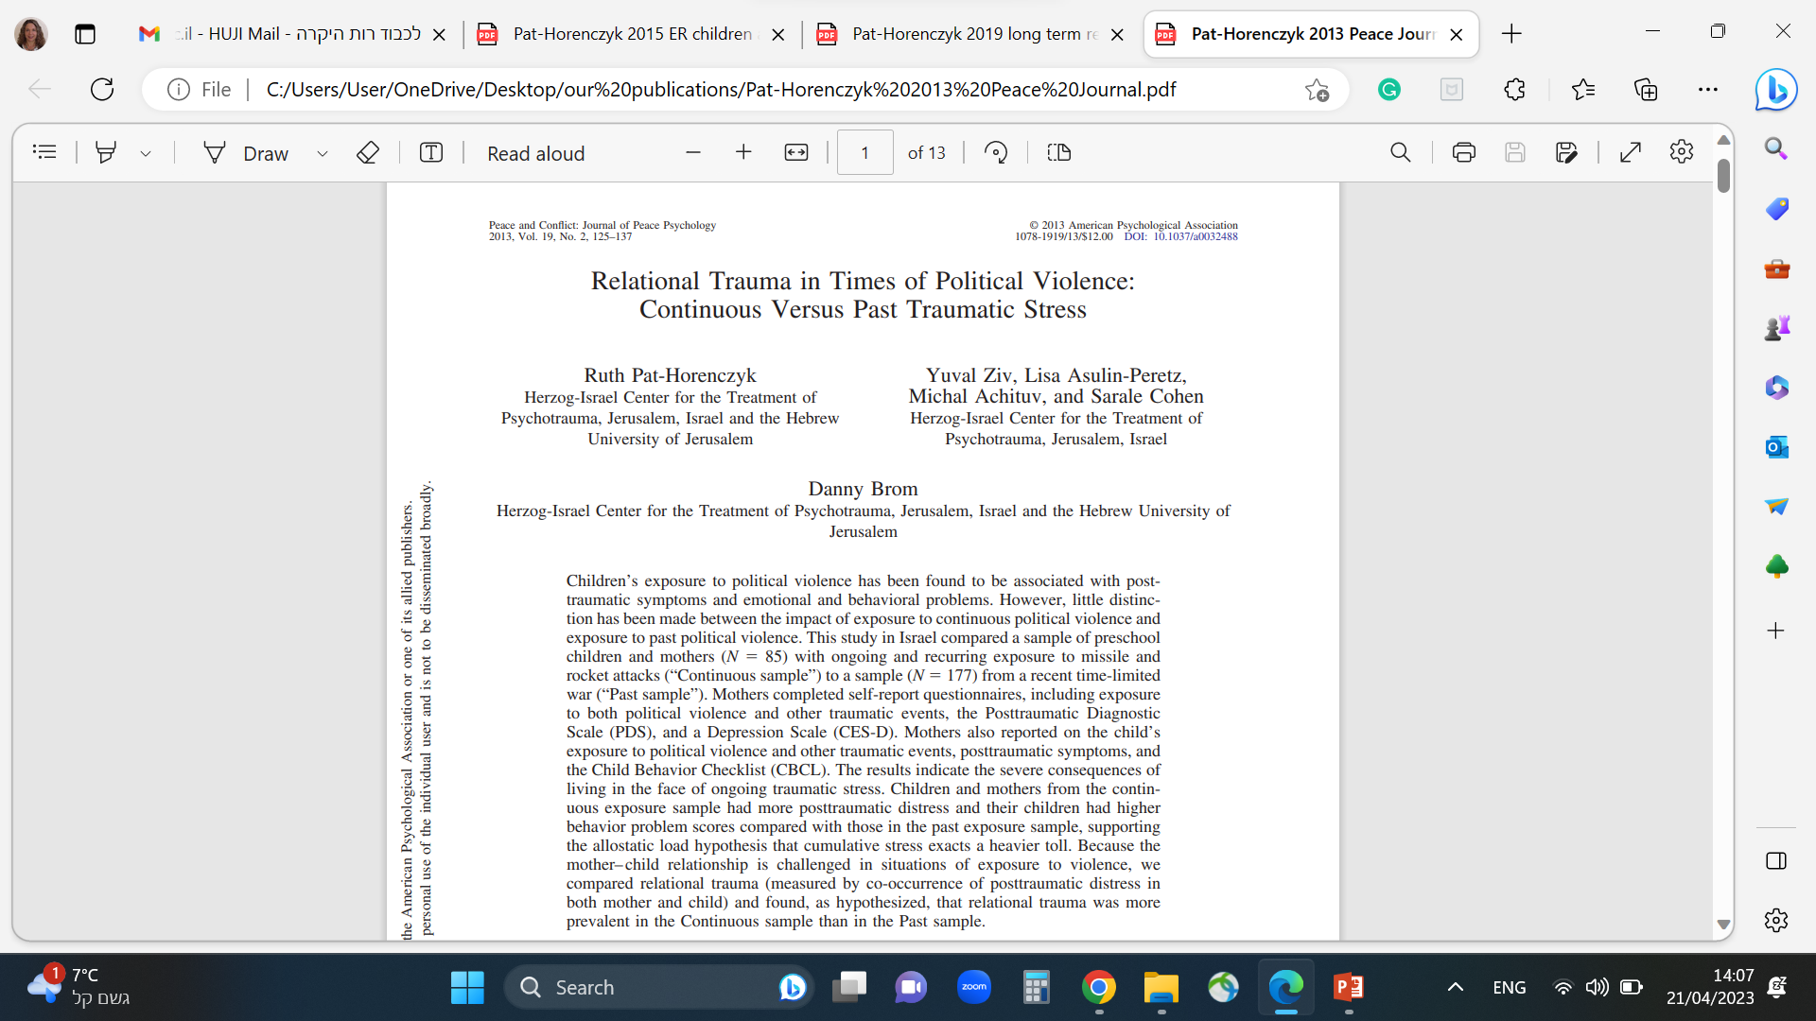
Relational Trauma
Continuous vs. Past Traumatic Stress

Slide 57






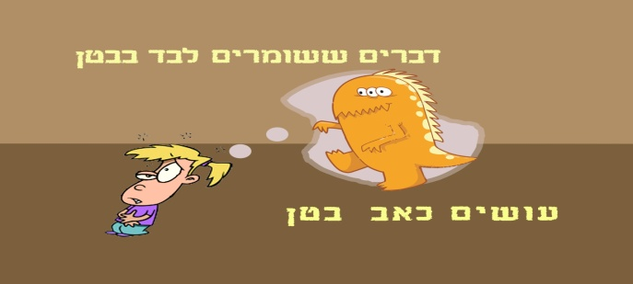
From Research to Interventions:
A program for Building Resilience for Parents and young children
Let’s Make Room for Play
Cohen, E., Pat-Horenczyk, R., & Haar-Shamir, D. (2014). Making room for play: An innovative intervention for toddlers and families under rocket fire. Clinical Social Work Journal, 42 (4), 336-345.‏ (DOI: 10.1007/s10615-013-0439-0).
Notes:
The phrase emphasizes the importance of taking time to look at our child unhurriedly and with love. This builds a strong bond between parent and child. When the parent takes time to Initiate exclusive attention to her child she conveys to her that she is available for her needs. In every day life the parents pay much attention to the child, but sometimes attention is given only after the seeks or demands it. When parent takes time to initiate a special meeting with the child it makes for a unique experience. This is an opportunity to really see the child and give them the feeling of being seen and loved. This builds a sense of self confidence in the child and a sense of trust in the parent.
Handkerchief rhyme –This rhyme accompanies every session. It is heartwarming to see how parent and child love to meet under the
handkerchief.
What else can we do together? – the children suggested - hug! hide together! tell secrets and much more
In each session the parent and child practice something that is related to the session’s theme (imagination, playfulness, emotions etc’.
57

Slide 58
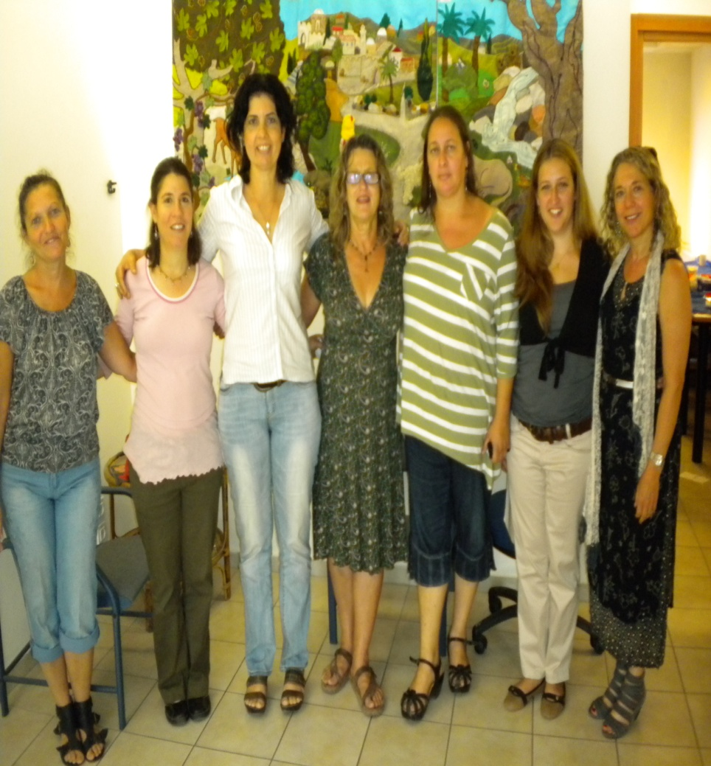

Our wonderful team

Slide 59
Program Objectives
Help improve the emotional and cognitive functioning of young children through play activities
Play activities involving the parent and child
Parent learns to play in new ways with the child
The child experiences the parent watching him with love and interest
Strengthen the parent-child bond

Slide 60

Principles of the Namal Program:
Themes of the 8 meetings:
Parent-child bond as a secure, protective base
Promotion of independence and self esteem
Playfulness, humor and creativity
Reflection of actions and intentions
Expression and reflection of feelings (emphasis on fear and anger and on the shifts between positive and negative feelings)
Play under trauma (post-traumatic play).
https://www.youtube.com/watch?v=SoB1AjVCueU

Slide 61
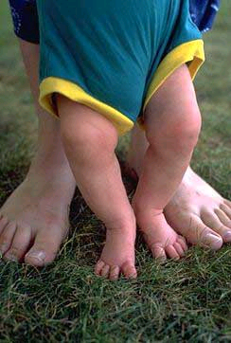
It takes a village to raise a child

Slide 62
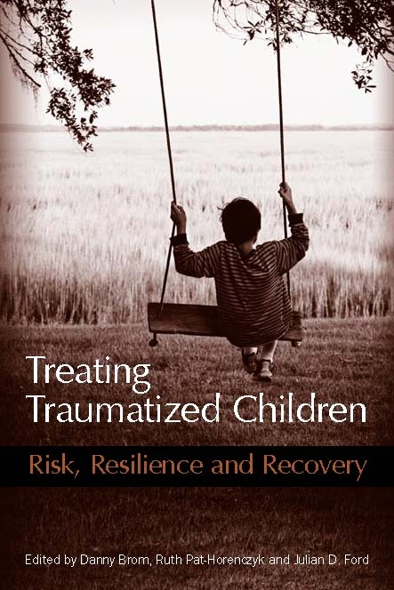
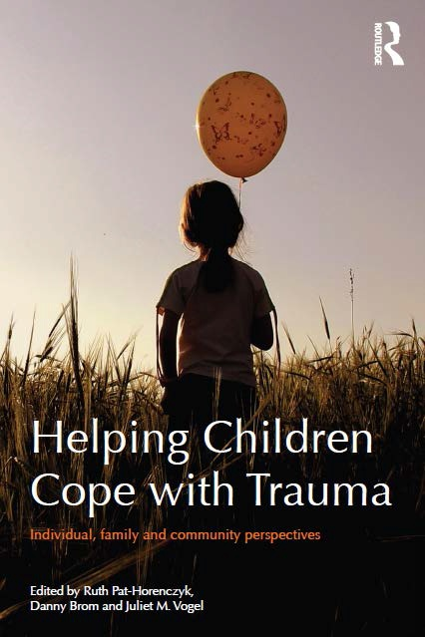
THANK YOU!

